Slide 1


Royal University of Bhutan
College of Science and Technology
Find A Doctor (Android App)
DITT Project
Client: JDWNRH, Thimphu.

Slide 2
Outlines
Aim
Problems/ issues with current scenario
Objectives
Scopes
Android App Demo
Web App (Admin Control Panel Demo)

Slide 3
Aim
To check the availability of a doctor in the hospital.

Slide 4
Problems/issues
Time consumption and expenditure
High traffic congestion and parking issues
Crowd at hospital
Inconvenience for aged people

Slide 5
Objectives
To create an Android Based App whereby a user can check the availability of the doctor in real-time, without having to visit the hospital.
To create the backend interface for Admin to maintain the information about doctors availability in the hospital (Web App).
To provide doctor a privilege to edit their status and availability only.

Slide 6
Scopes
emergency contacts
Notification
Admin Interface
Search
App Interface for doctors
Login
Find A Doctor
App Interface for General users
About us
Rate us
Feedback
Help

Slide 7
Progress (Android App Demo)

Slide 8
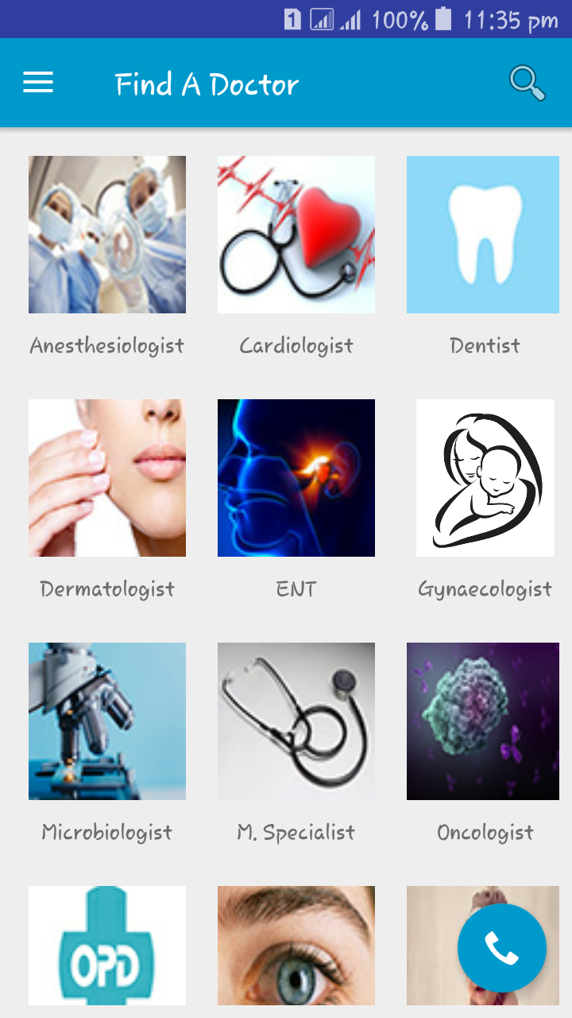
Main screen

Slide 9
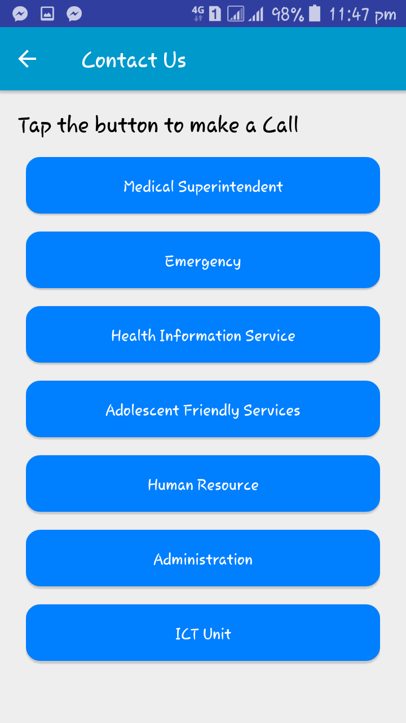
Emergency contacts Feature

Slide 10
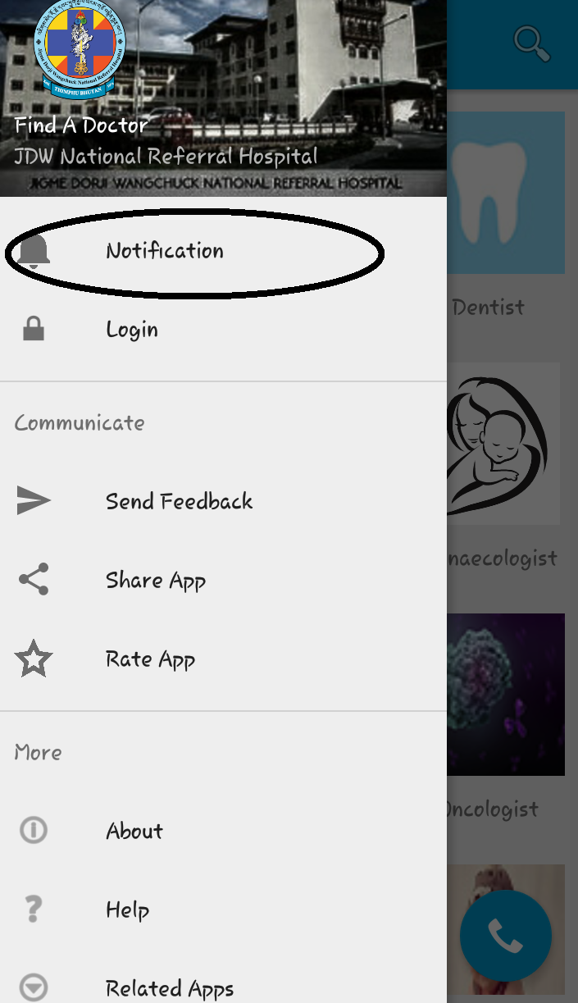
Drawer screen

Slide 11
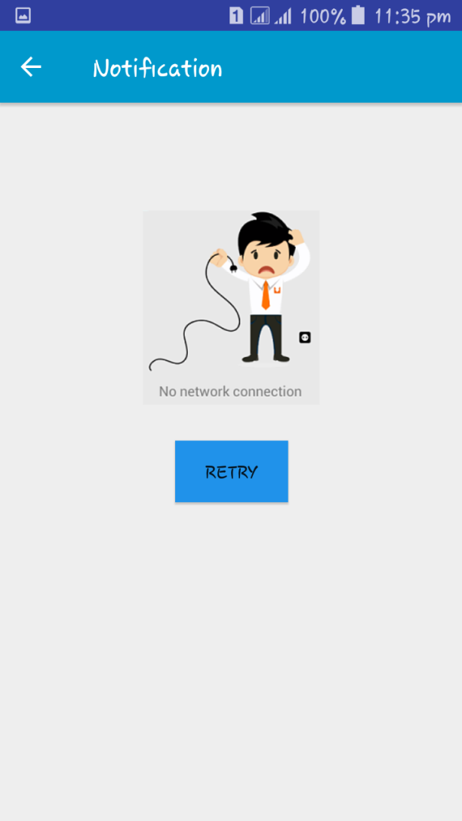
Notification feature

Slide 12
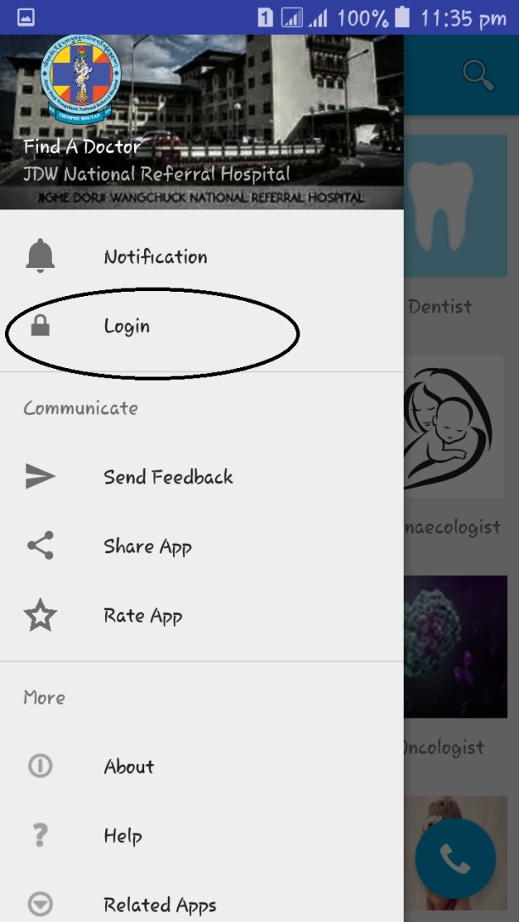
Drawer screen

Slide 13
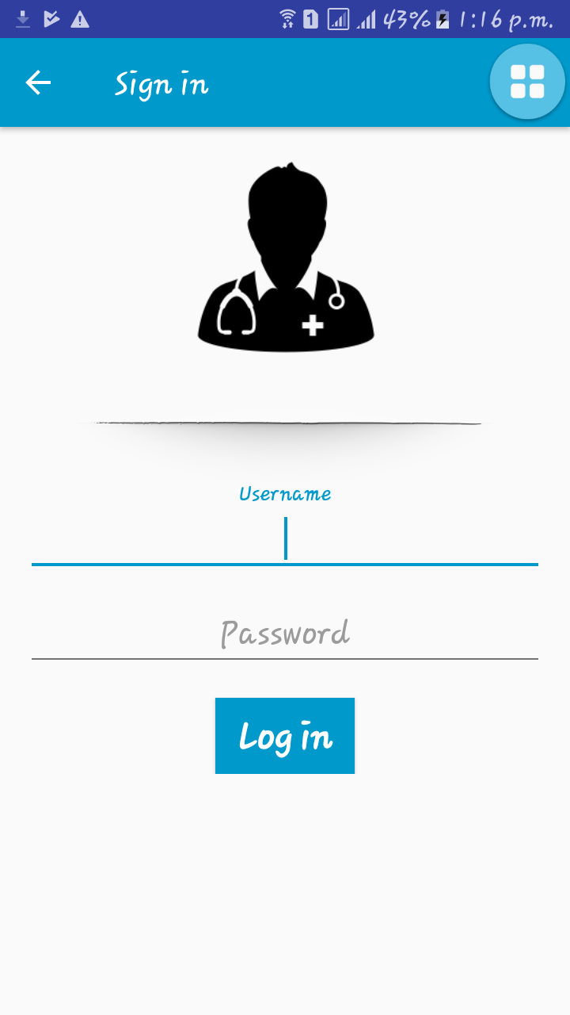
Login Feature

Slide 14
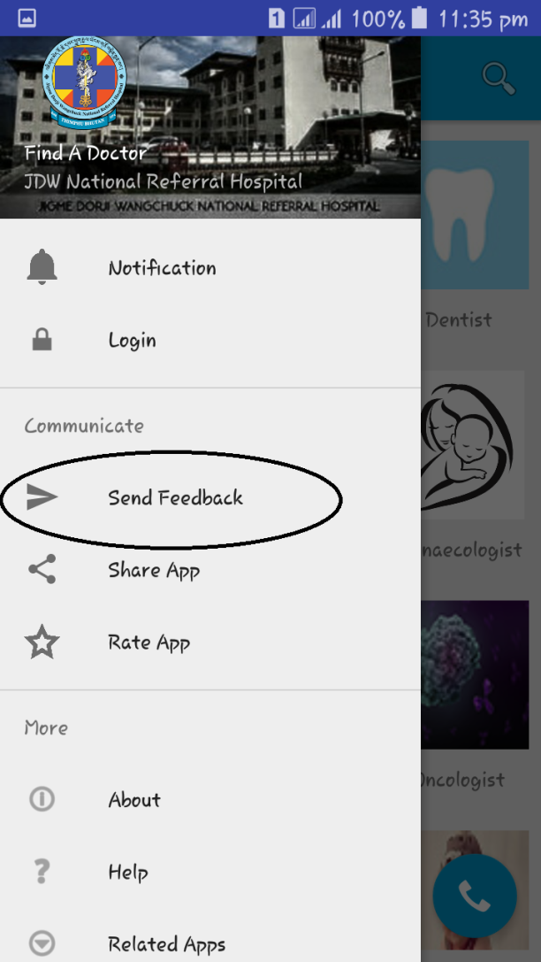
Drawer screen

Slide 15
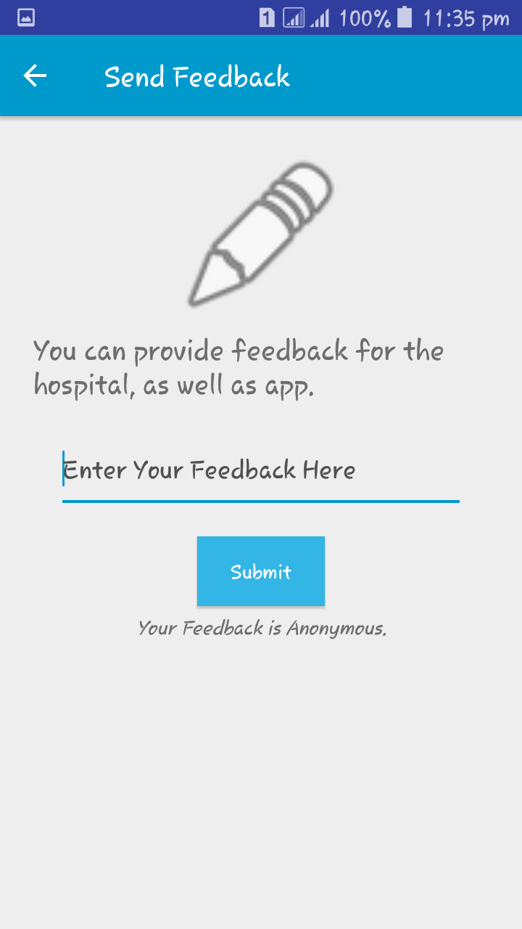
Feedback feature

Slide 16

Drawer screen

Slide 17
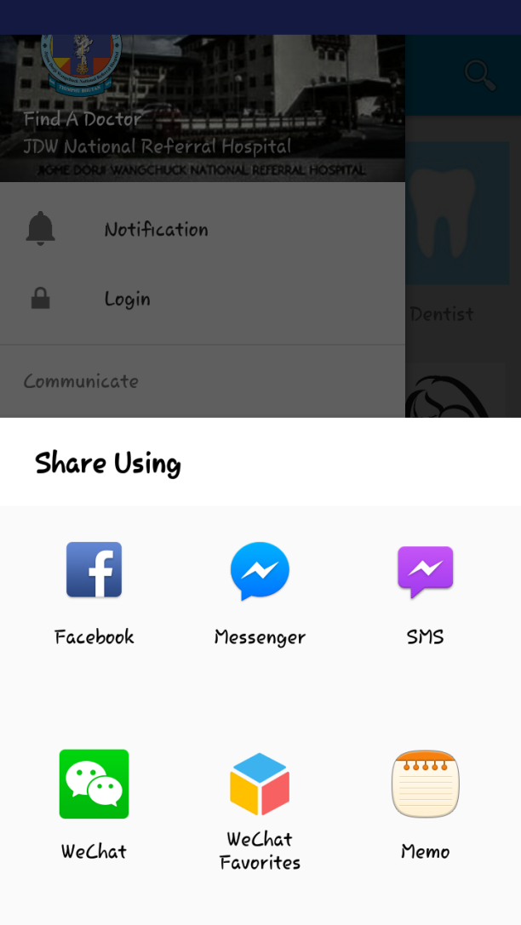
Share App Feature

Slide 18
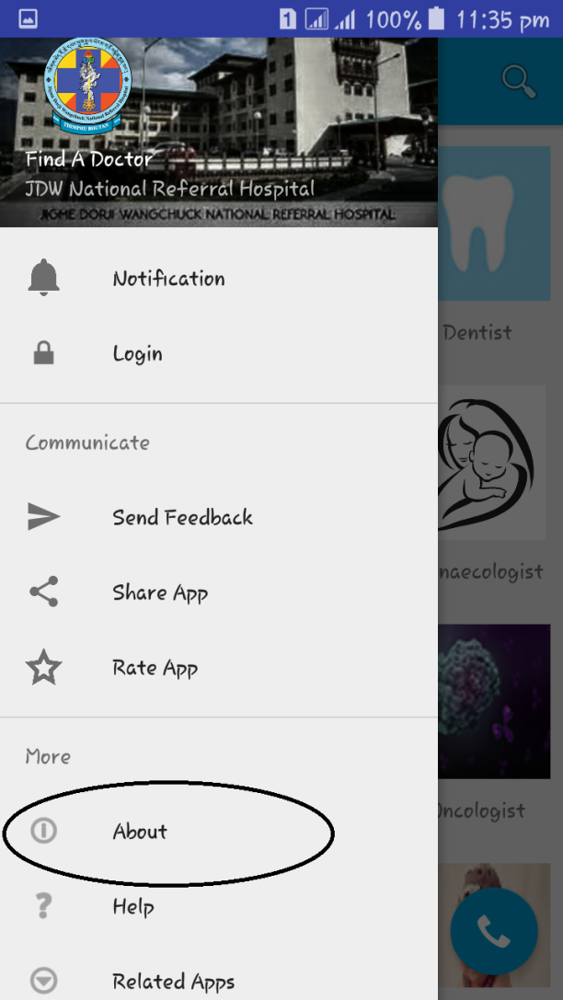
Drawer screen

Slide 19
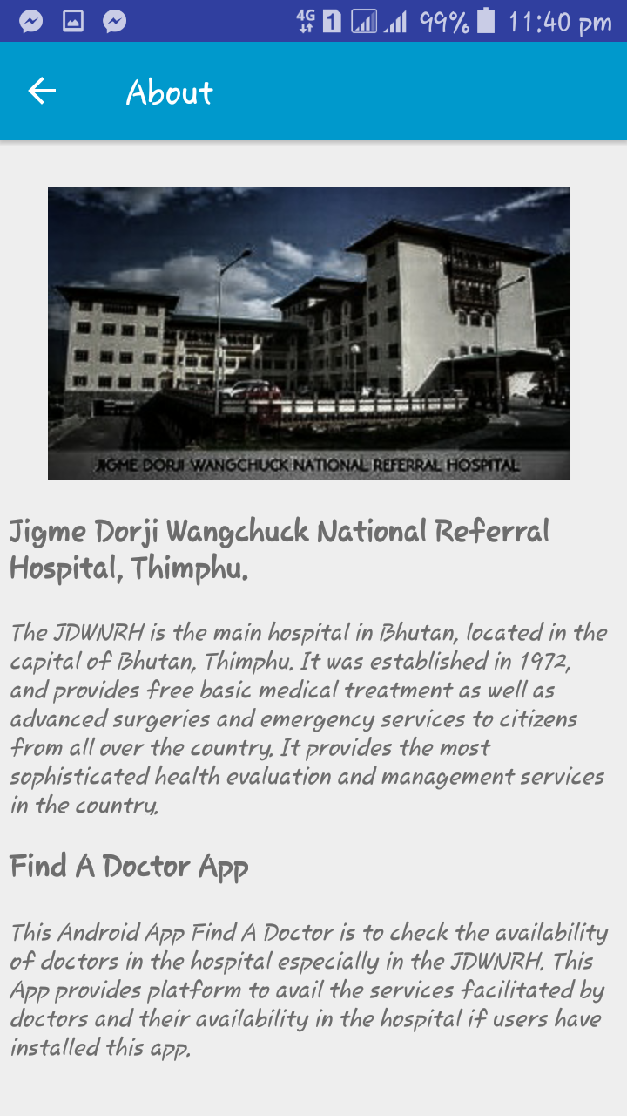
About us Feature

Slide 20
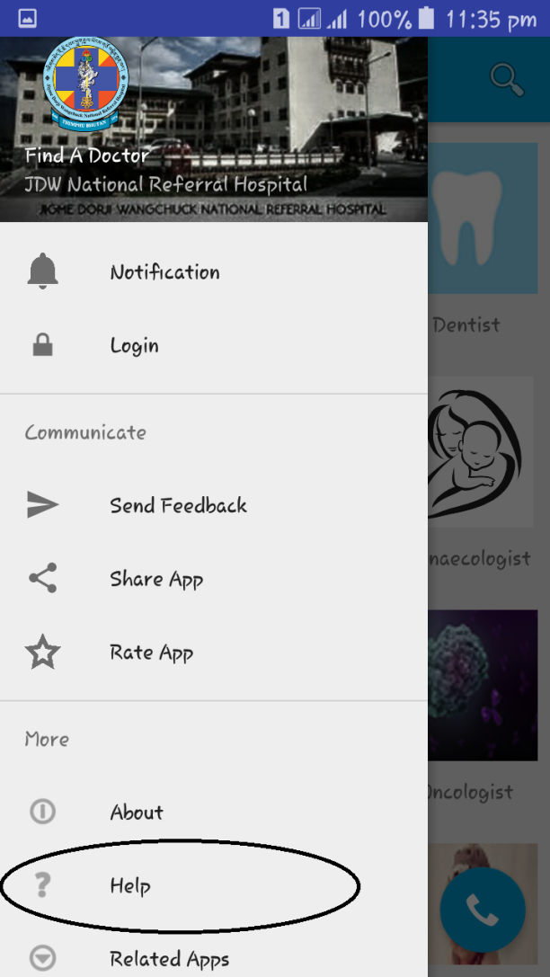
Drawer screen

Slide 21
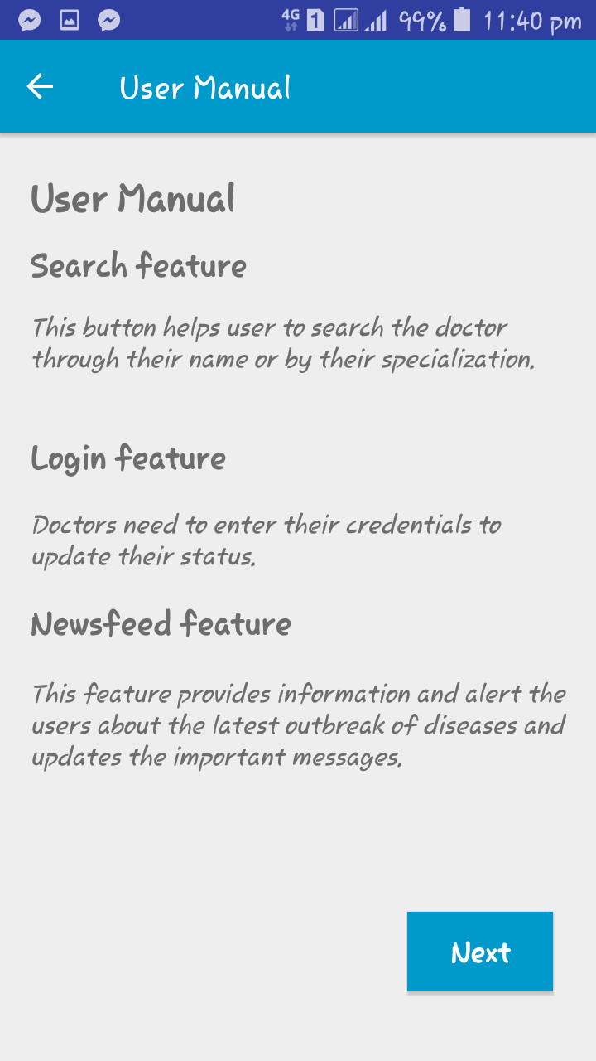
Help Feature

Slide 22
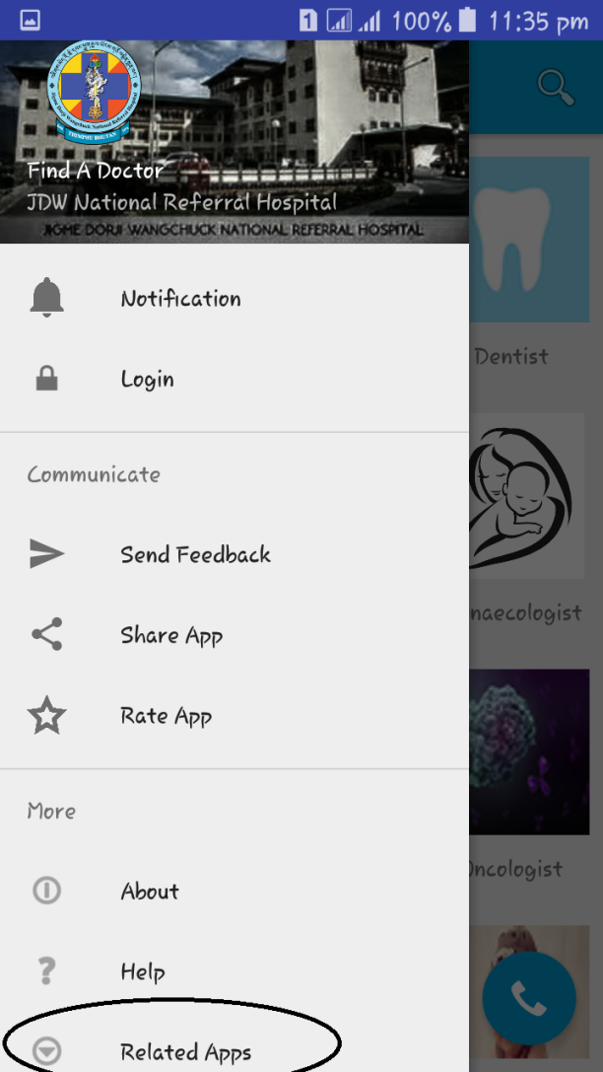
Drawer screen

Slide 23
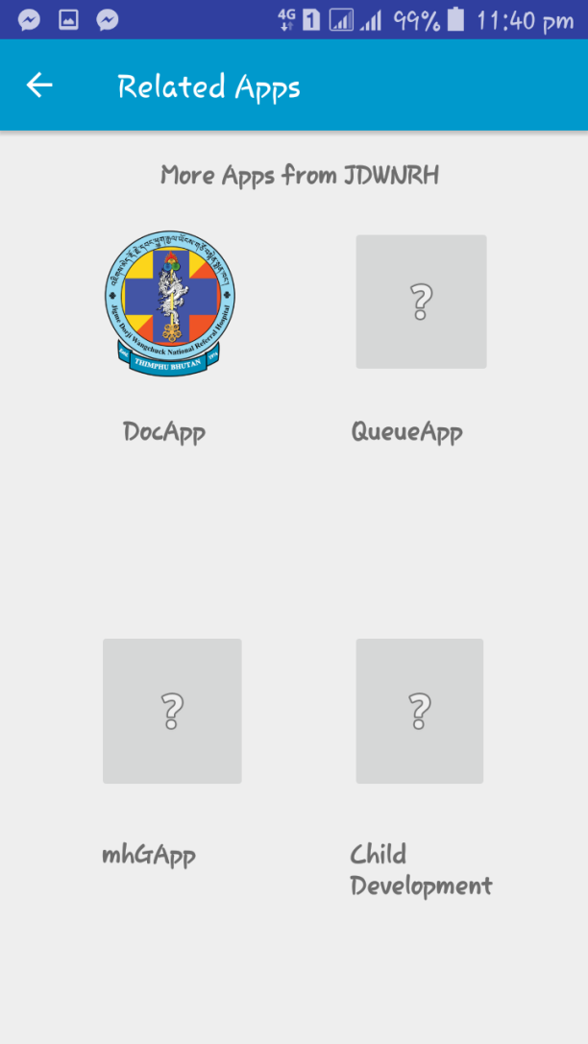
Related Apps feature

Slide 24
Thank you
Group members:
Khusanth Chhetri
Karma Dorji
Deepika Suberi
Tula Ram Ghalley
Megnath Sharma
Gagendra Ghalley
Tshering Penjor
Kinzang Pelden

